Slide 1

Gagan Soni(21)
Adarsh Shukla(60)
Neha Chauhan(67)
M.Sc. Computer Science 2022-24
MCSC201- MACHINE LEARNING ASSIGNMENT 1
Bias-Variance trade-off for Model Selection

Slide 2

Table Of Content
1. Problem Statement
2. Dataset generation
3. Dataset Representation
4. Value Calculation
5. Polynomial Fitting
6. Bias, Variance, Training Error, Testing Error and Total Error
7. Error Plotting
8. Optimal Degree Calculation
9. Fitting Optimal Degree
10. References

Slide 3
Problem Statement
Take a trigonometric function and a choose an error function (N(0, sigma-sq)). Generate data set of 10,000 instances. Fit polynomials of order 1 - 10 and estimate and plot total error, Bias, Variance,
training and validation error for each using 10-fold cross validation. Create the folds using Python function and compute all errors using the equations given in textbook. Select the optimal model.
For the selected model, estimate and plot total error, Bias, Variance, training and validation error for training set sizes 1K, 2K, ... 10K. Use 10-fold cross validation for each training set, and the functions coded earlier for estimating the error.

Slide 4
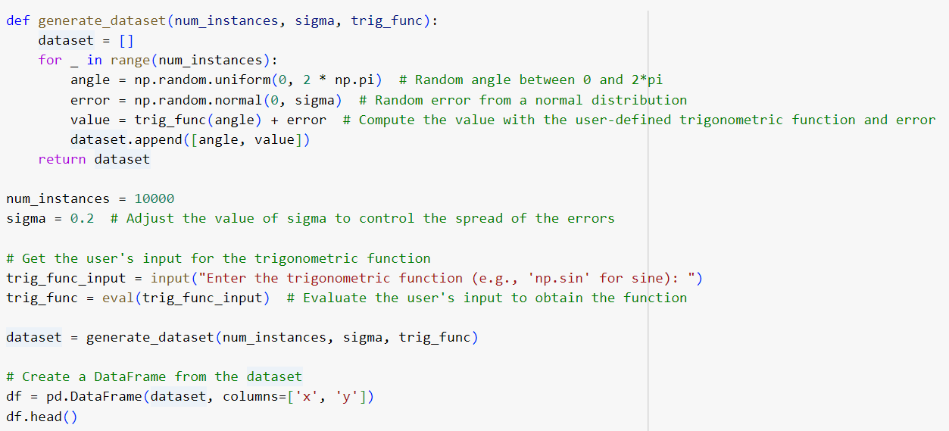
Dataset Generation
Trignometric function is taken as user input using format np.trig_func e.g. np.sin for sine.
Angles are generated using random function and noise using normal distribution(randomly).
Dataframe is generated from the dataset generated.

Slide 5
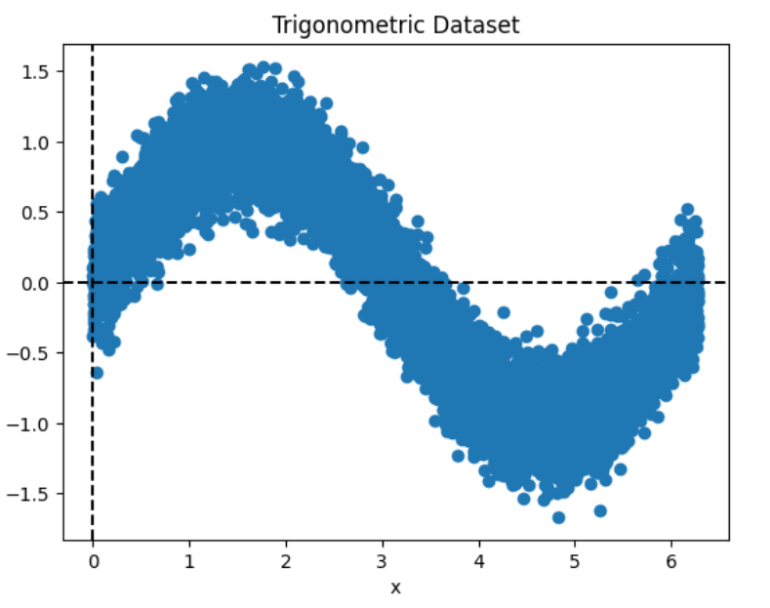
Dataset Representation
Input trignometric function : np.sin(i.e. sine function).
x-axis represents the angle between 0 and 2π.
y-axis represents value of trignometric function for the given angle.

Slide 6
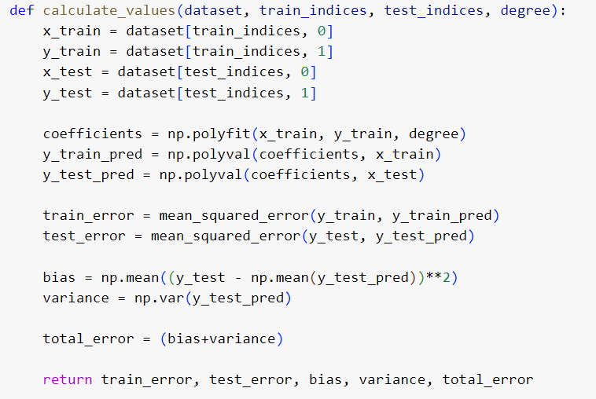
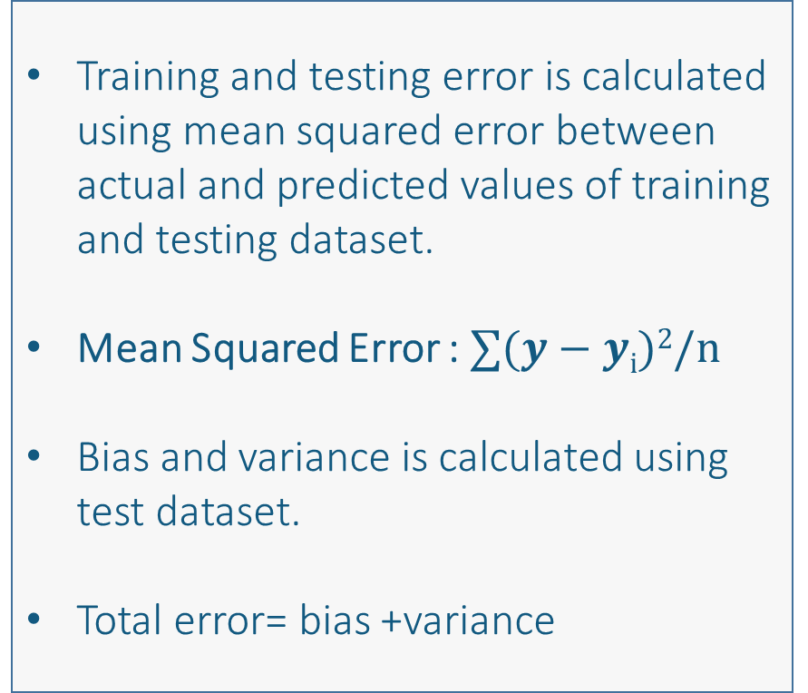
Value Calculation
Training and testing error is calculated using mean squared error between actual and predicted values of training and testing dataset.
Mean Squared Error : $∑(y−yi)2/n$
Bias and variance is calculated using test dataset.
Total error= bias +variance

Slide 7
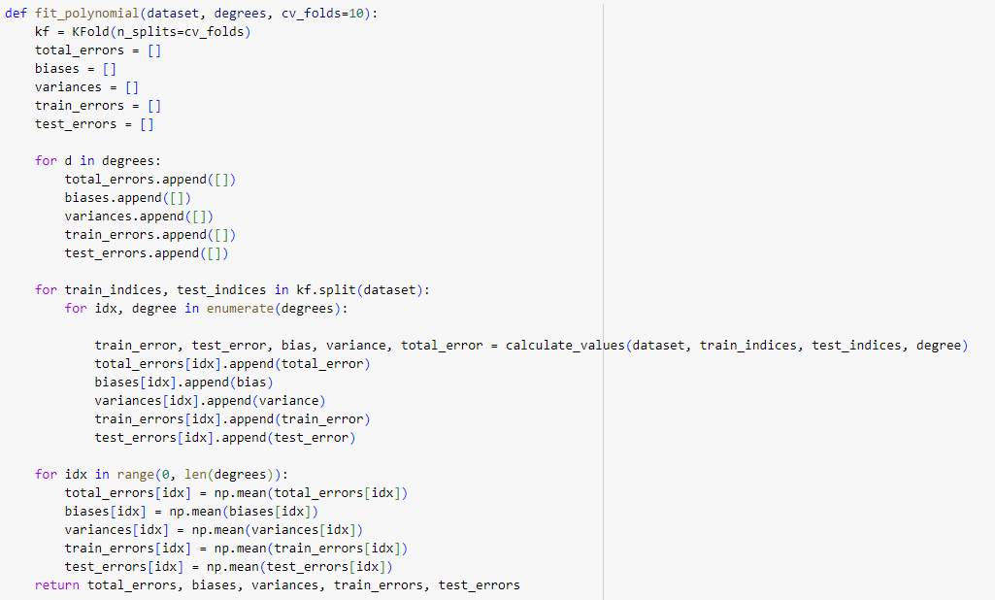
Polynomial Fitting
We need to calculate bias, variance, training error, testing error and total error using 10-fold cross validation.
K-fold cross validation : K-Fold is validation technique in which we split the data into k-subsets and the holdout method is repeated k-times where each of the k subsets are used as test set and other k-1 subsets are used for the training purpose. Then the average error from all these k trials is computed.

Slide 8
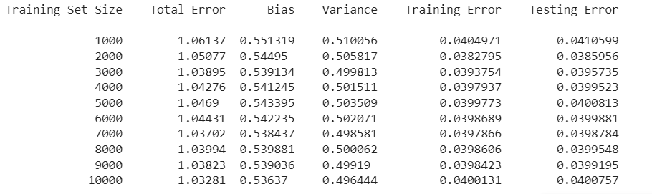
Bias, Variance, Training Error, Testing Error and Total Error

Slide 9
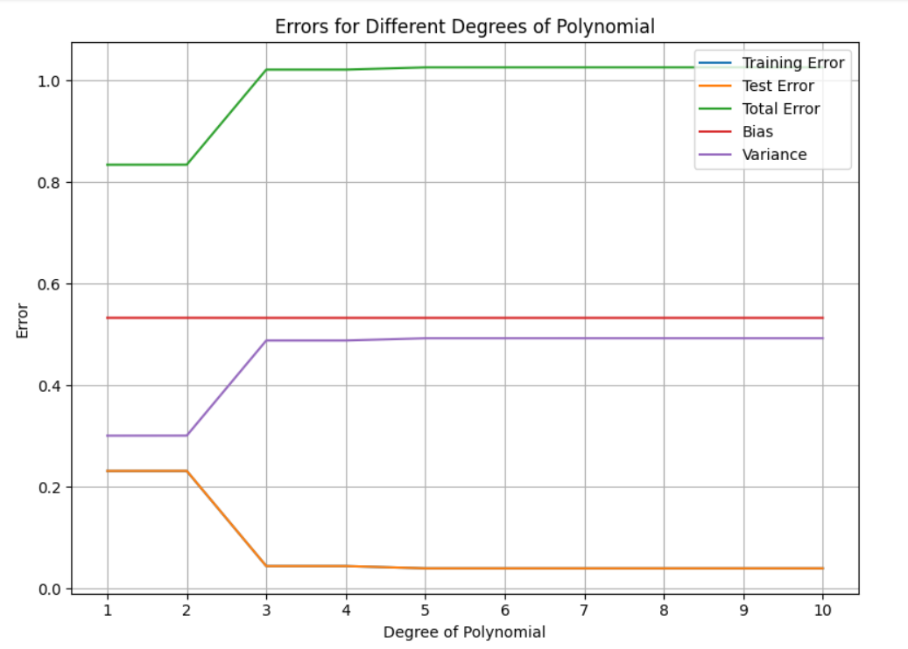
Error Plotting
Bias, Variance, Training error, Testing error and Total error generated earlier is plotted for different degree of polynomial.
x-axis represents the degree of ploynomial.
y-axis represents the error.

Slide 10
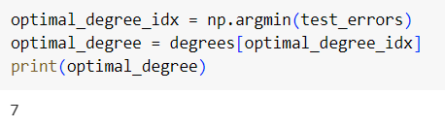
Optimal degree Calculation
Optimal degree is the degree of polynomial for which the model is best fit.
For the taken function sin(in our case) the optimal degree is 7.

Slide 11
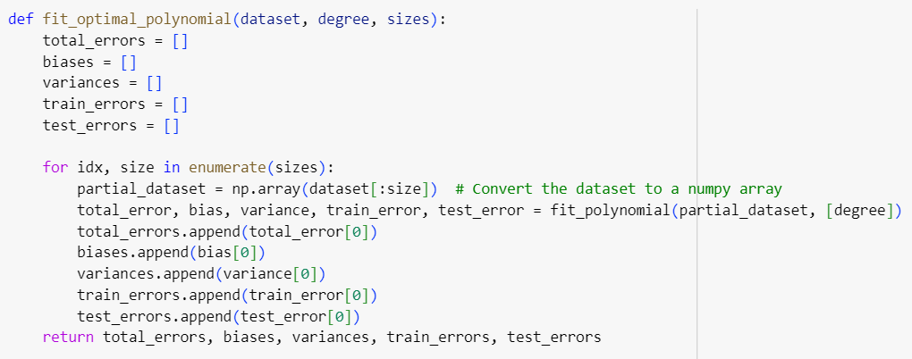
Fitting Optimal Polynomial
Till now optimal degree is calculated i.e. 7, now the optimal polynomial of degree 7 is needed to be fitted.
Now the bias, variance, test error, training error and total error is calculated each for 1k,2k,3k,.....,10k size dataset using 10-fold cross validation.

Slide 13
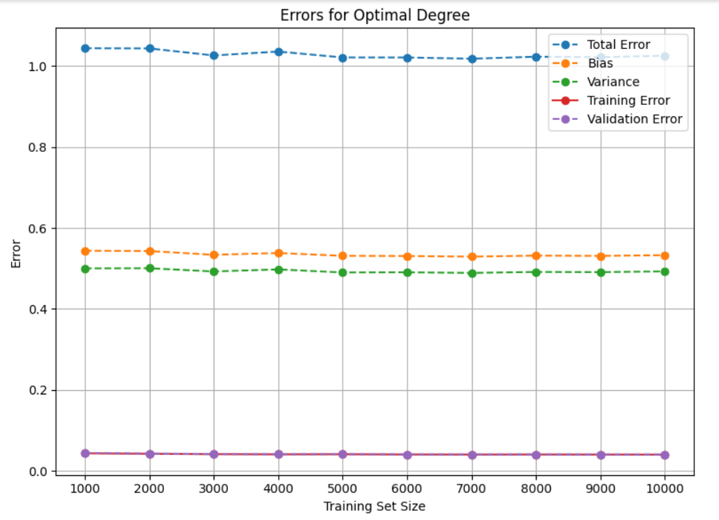
Optimal Degree Error Plotting
Finally the error plotting for the optimal degree i.e. 7(in our case) is done.
x-axis shows Training set size i.e. 1k, 2k, 3k,......,10k.
y-axis shows error.

Slide 14
References
Introduction to Machine Learning by Ethem Alpaydin.

Slide 15
Thank You...

